Slide 1
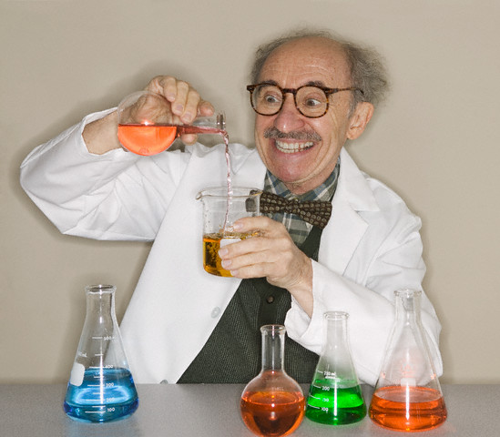
Notes:
Sooo.. if i add this two together I will get this amount. So mix the chemicals together and… Eureka! I got! I have done! I can save you I can save you! Yes! After years of ambition, studying, testing, and now I have created…!

Slide 2
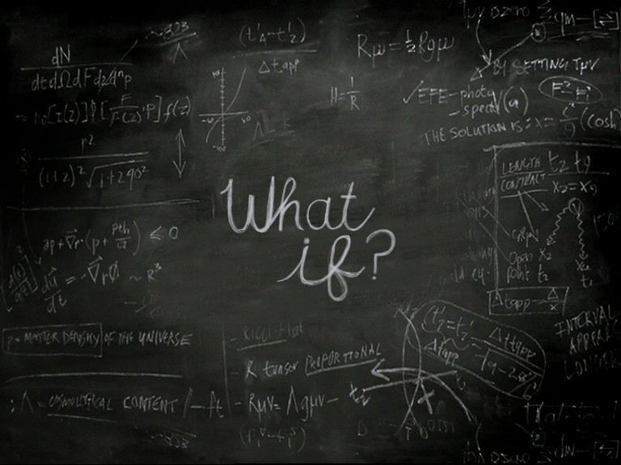
Notes:
I guess I should tell you why I am celebrating. Might as well start from the beginning. Let’s Rewind. It all started when I was a small boy. I was a questioner. My mom still calls me the “What if” man to this day! I asked what if I did this to this, or this to this. All she said was “I don’t know”. And I would ask if I could try it- that is if it was in my limitations.

Slide 3
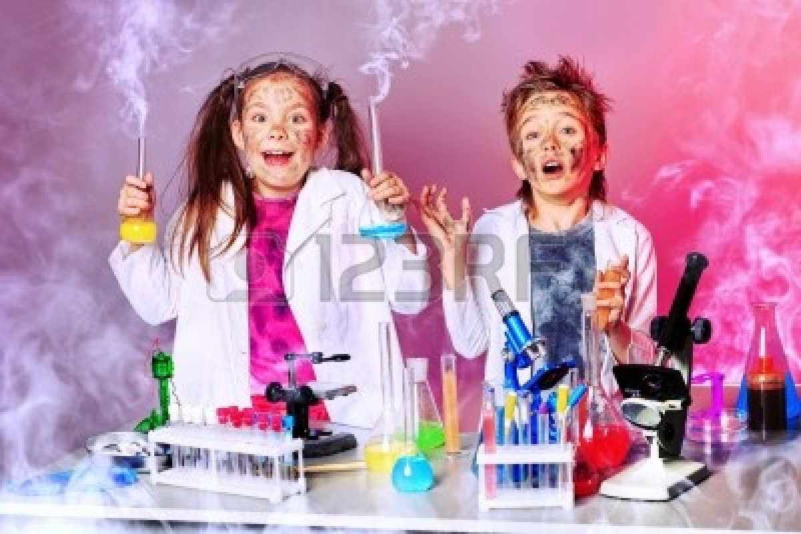
Notes:
She would say “as long as you don’t blow the house up!” So I experimented, making a ton of messes, but never blowing up the house. I also questioned why to everything! Why this why that. I even got in trouble in elementary school, actually even in high school for asking too many questions. I wanted to know why things happened and I wanted to fix them or make them better.

Slide 4
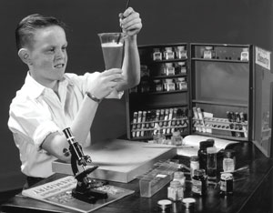
Notes:
I found in this what if and why obsession a love for science. I got chemistry sets and microscopes as birthday and christmas presents. I hid them under my bathroom sink, and everyday I put on my white lab coat and my bulky goggles, and took it out and mixed different chemicals together. I loved it.

Slide 5
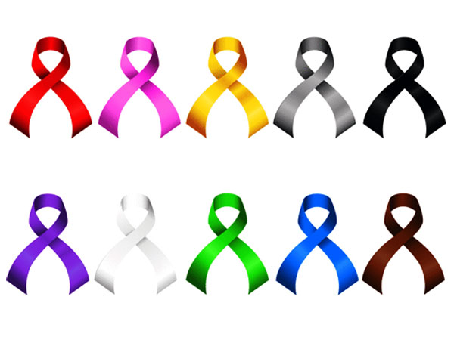
Notes:
Now comes to the important part. The part my whole presentation, no life hinges on. It was the moment where I told myself and my parents that I will cure cancer. Cure cancer- wow- now that is a big task for a little boy. But I still want to do it to this day.

Slide 6
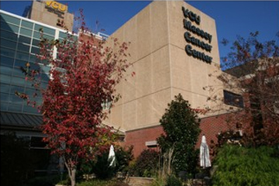
Notes:
My internship this year will be at VCU Massey Center, working alongside a Dr. Landry and conducting cancer research. I am going to college to study chemistry so I can do exactly that later on in life! I have collected articles, have done research, and have explored the domain of cancer. This is my dream and passion.

Slide 7
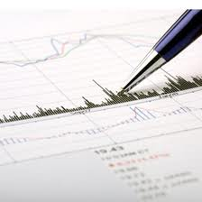
Notes:
Everyone has been impacted by cancer whether directly or indirectly. 2.6 million women alive in 2008 had a history of breast cancer. It was projected that in 2011 almost 40,000 women would die from it. It was projected in 2012 that about 1,500 people would die of bone cancer. And it was estimated that about 160,00 people in the U.S. would die of lung cancer in 2013.

Slide 8
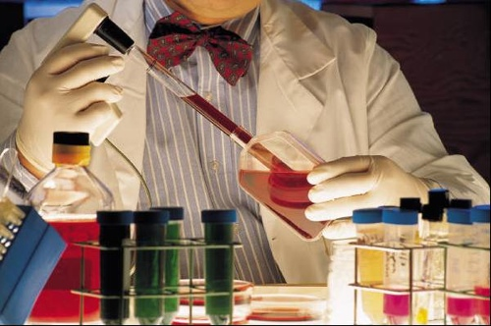
Notes:
Each year 12.7 million people learn that they have cancer, and 7.6 million people die from this disease. This is why it is my passion, because so many people are affected by it, and also because I know I can make a difference. I like to solve things and mix chemicals. I want to be in the lab and create new things, so why not something that will save millions of people’s lives?

Slide 9
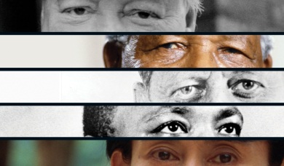
Notes:
The Race for the Cure directly correlates with leadership. There are so many parts to the whole race. There are researchers, nurses, companies that fundraise, donators, and the cancer patient themself and all of them each play a vital role as a leader in the race to beat cancer. Even though they are all leaders-they are a unit. They all need each other to function- to be successful.

Slide 10
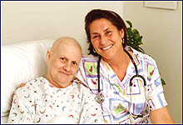
Notes:
First the nurses and doctors are leaders. Leaders have patience, compassion, dedication,and can deal with any situation. Nurses are there for the patients .They show compassion towards them everyday. They are patient with the families who have worries, who are tired, and who are money stricken. They have to deal with situations none of us have seen. They help them through their new walk of life.

Slide 11
Notes:
Secondly the companies who fundraise are huge leaders in the race for the cure. They help collect money and spread the word. Leaders have to be heard, they have to get their message out clearly and to everyone. And that is exactly what these companies have to do. They have to spread the word. They also have to be encouraging. They have to encourage the world to get involved. Let them, us, know we can make a difference.

Slide 12
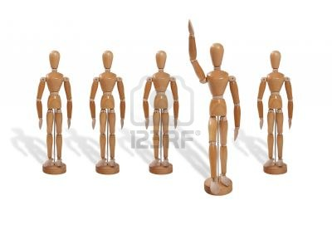
Notes:
Companies who fundraise are also leaders because they have initiative. they have a goal, something to work towards. They will do anything to accomplish their goal. In this they have to be open-minded, ready to hear new ideas and think outside the box. The companies must be ready to adapt to new environments, geographics for different events,and new problems. They work toward their goal. they take initiative and get things done.

Slide 13
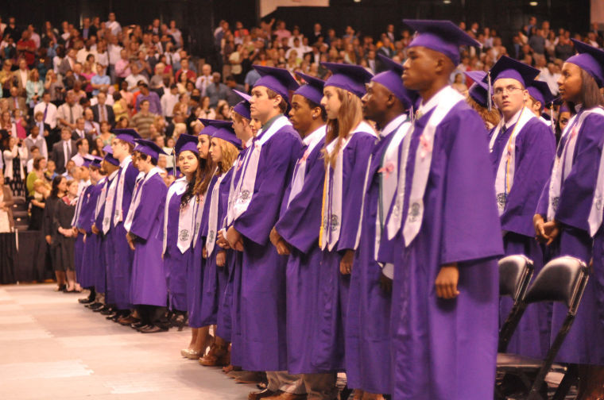
Notes:
Thirdly the donators, so us, are leaders. We have to be influential to get others to donate throughout our school, community, families, and everywhere. We are the root of success. Without us there would be no funds for research, no funds for treatment, no funds for healthy people around the world. We are leaders in the race for the cure!

Slide 14
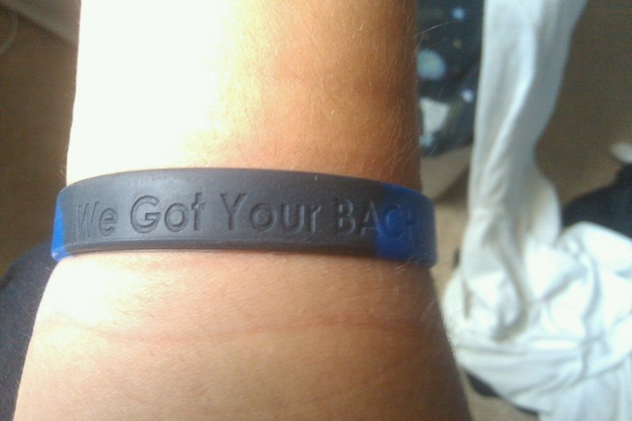
Notes:
We can also be leader just by being a security blanket. A warm welcome home. During our high school career we had a fellow classmate, Zach Bach, be diagnosed with bone cancer. And what did we do? We sold bracelets and in this raised money for him and his family. But above all we were there for him. We cared for him and comforted him, but also just accepted him like he was still a normal teenager.

Slide 15
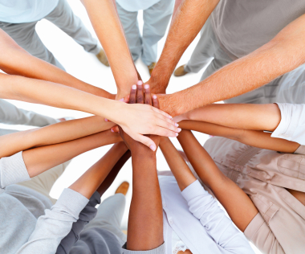
Notes:
Lastly, and maybe the most important, the patients themselves are leaders. Leaders everyday have to cooperate with new people, followers, political figures, and even laws..Leaders have to adapt to whatever comes their way. Whether it be new laws that limit them, new people protesting against them, or new followers. They must adapt.

Slide 16
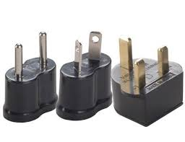
Notes:
Patients have to COOPERATE they have to ADAPT to the new situation. They have to deal with new people, new faces, and new circumstances. They must ADAPT to survive. If they do not adapt they will keep on sulking saying “why me?” They have to accept their cancer, to embrace it, to their cancer doesn’t control them, but they control their cancer and their life.

Slide 17
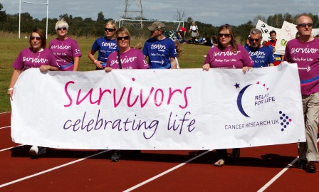
Notes:
Another way they lead is a way we are all affected by. Their will to live. They INSPIRE! Isn't that what a leader does. Inspire others to make a change. Every new day a cancer patients makes it through, they inspire us more and more. They inspire us to live more, to laugh more, and to love more. They inspire us to push through the pains of life.

Slide 18
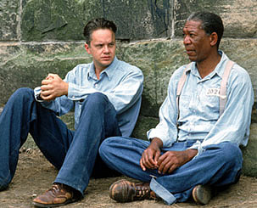
Notes:
It is summed up by Andy from the Shawshank Redemption. He was sitting in the courtyard of the jail talking to Red about Zihuatanejo. Andy asked Red to join him, but he said he couldn't make it in the outside world. Andy responded with“ Get busy living or get busy dying.” Each day a cancer patient makes it through they are telling us we can make it through life. They inspire us to live, and to enjoy life!

Slide 19
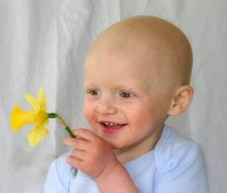
Notes:
The race for the cure is my passion. Curing cancer by working in the lab and creating new drugs. Everybody in the race for the cure as a role to play and they are all leaders in making a change, a difference, making one more boy or girl smile each and everyday. They can comfort, they can encourage, and they can inspire!

Slide 20
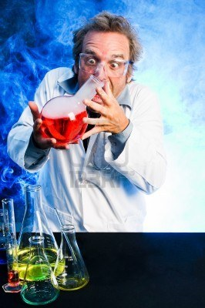
Notes:
Sooo.. if i add this two together I will get this amount. So mix the chemicals together and… Eureka! I got! I have done! I can save you I can save you! Yes! After years of ambition, studying, testing, and now I have created…! A CURE FOR CANCER!!!!!!

